Slide 1
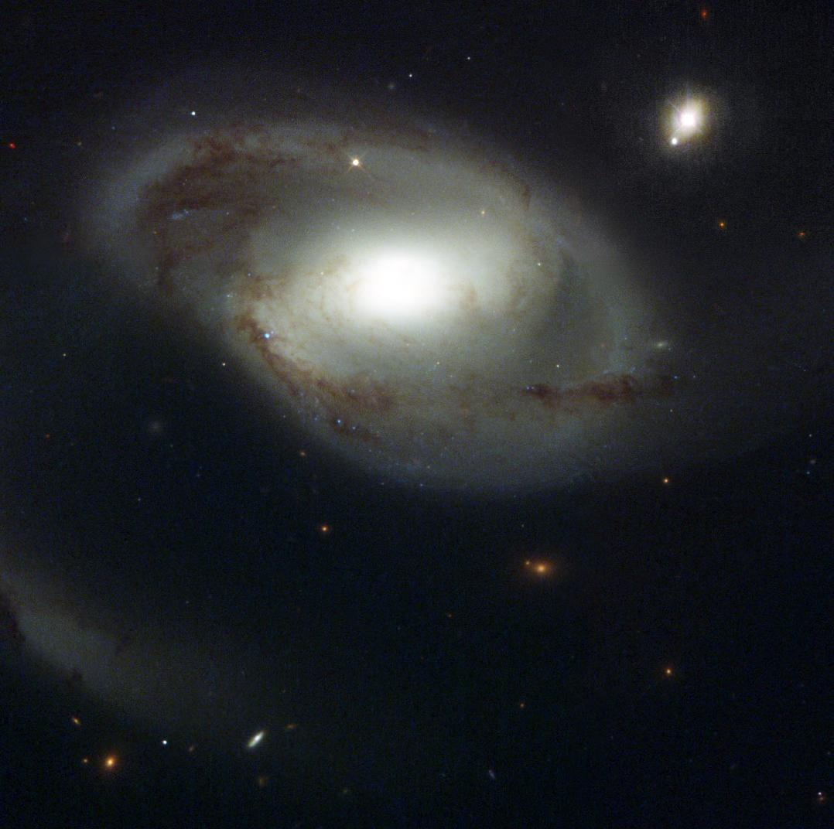
Does the gas in the IGM care about galaxies?
Tracing the Circumgalactic Medium in Lyα with COS
David M. French
Thesis Advisor: Bart Wakker
University of Wisconsin - Madison
Jan 11, 2018
Image Credit: NASA and The Hubble Heritage Team (STScI/AURA)

Slide 2
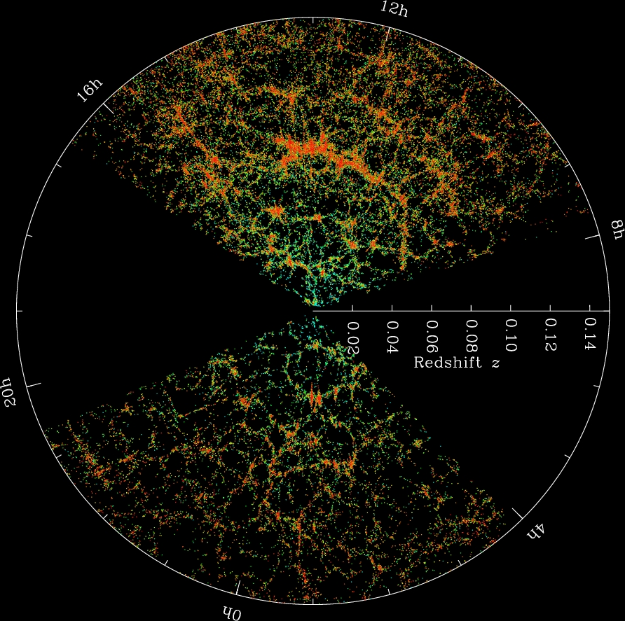
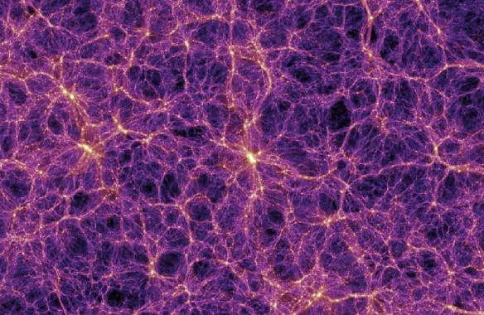
Gas + galaxies trace the same potential
The Millenium Simulation
SDSS Collaboration
Notes:
Gas collapsed with DM into filaments = cosmic web, formed galaxies

Slide 3
Does the gas care about the galaxies?
Gas and galaxies follow the same DM potential
Galaxies need to continue accreting gas over cosmic time to match observations
Feedback kicks gas out of galaxies
How do the properties of halo gas correlate with nearby galaxy properties?

Slide 4
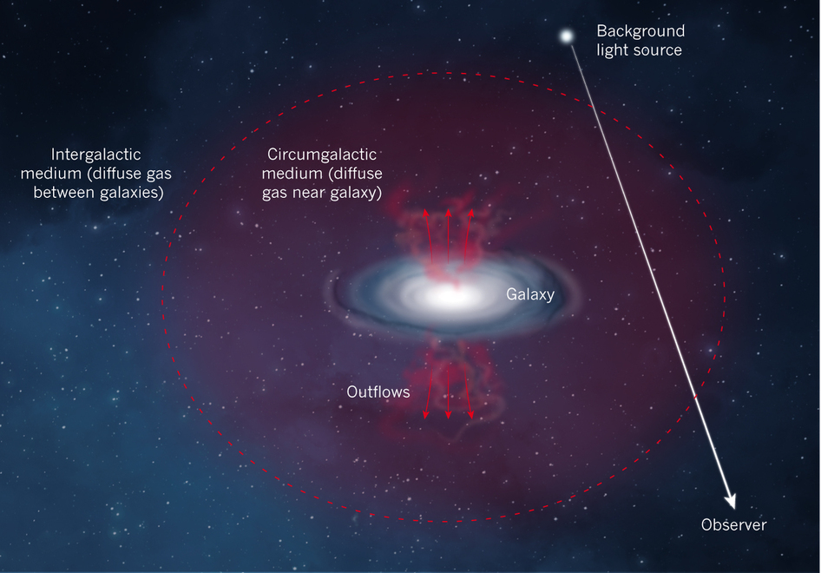
Probing the CGM with QSO absorption
Relying on serendipitous QSO locations
Build a sample of single galaxy-QSO pairs
Impact parameter and ΔV give absorber position
ΔV
Impact parameter (ρ)
Nature 517, 444
Notes:
Put one of these first

Slide 5
Science Outline
Stay close (z < 0.034, cz < 10,000 km/s)
- Available galaxy data complete to ~0.2 L*
Use archival COS sightlines (~700)
- Find Lyα, associate with galaxy environment
Automate associating galaxies – absorbers
Ask: absorber (EW, N(HI), velocity)
as a function of
galaxy (impact parameter, size, orientation)

Slide 6
Science Outline
Use archival COS sightlines (~700)
Concentrating on Ly-alpha lines
Correlate with galaxy environment
Limit search to cz < 10,000 km/s
Ask
absorber(EW, velocity) vs galaxy properties (size, proximity, orientation)

Slide 7
Science Outline
Use archival COS sightlines (~700)
Find Lyα, associate with galaxy environment
Ask: absorber properties (EW, N(HI), velocity)
as a function of
galaxy properties (impact parameter, size, orientation)

Slide 8
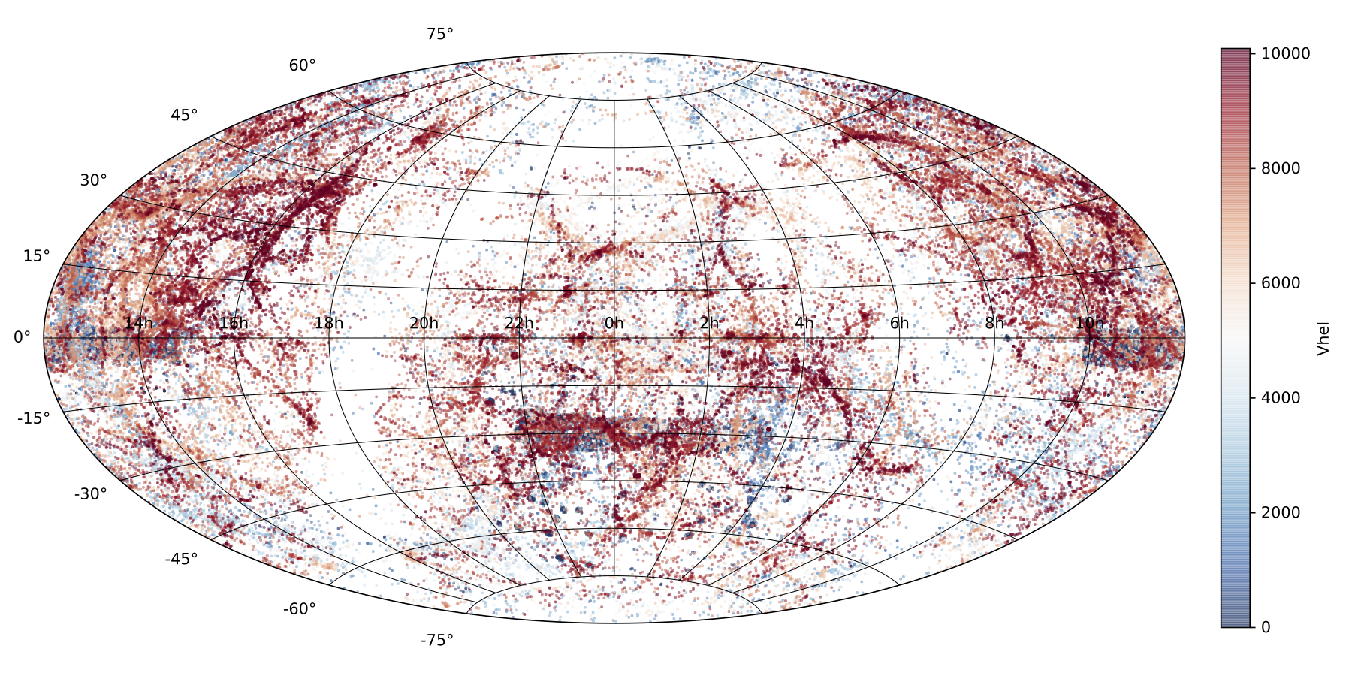
First – New Nearby Galaxy Catalog
Gather and homogenize existing galaxy data
NED + IRSA
130,000+ galaxies with cz < 10,000 km/s
French & Wakker 2018, in prep

Slide 9
New Nearby Galaxy Catalog
Homogenize existing data
Normalize diameters, inclination, PA to 2MASS values
Choose magnitudes, calculate (L*, R_{vir})
French & Wakker 2018, in prep

Slide 10
New Nearby Galaxy Catalog
Homogenize existing data
Normalize diameters, inclination, PA to 2MASS values
Choose magnitudes, calculate (L*, R_{vir})
French & Wakker 2018, in prep

Slide 11
Step 2
Model the velocity structure probed by a QSO sightline

Slide 12
Model sightline velocity structure
Is there Halo – disk kinematic connection?
CGCG039-137 : vhel = 6918 km/s
French & Wakker 2018, in prep
French & Wakker 2018, in prep

Slide 13
Step 2
The halo – disk kinematic connection
Model the sightline velocity
CGCG039-137 : vhel = 6918 km/s
French & Wakker 2018, in prep

Slide 14
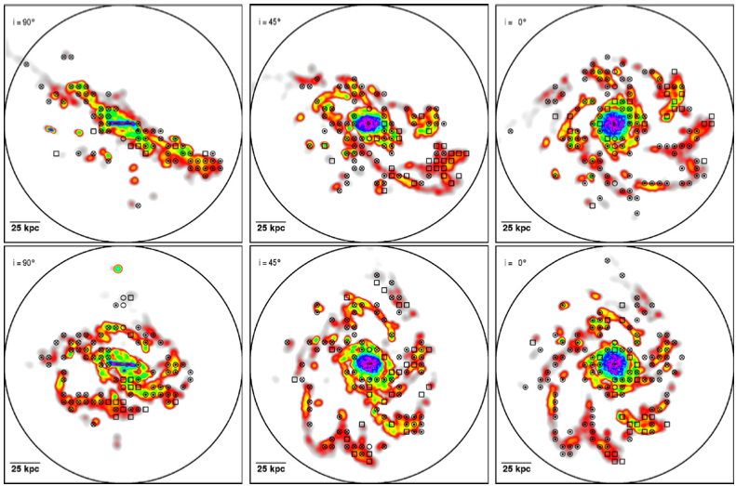
Step 2
The halo – disk kinematic connection
Is there one?
Stewart+ 2011

Slide 15
Model sightline velocity structure
The halo – disk kinematic connection
Rotation curves from SALT
French & Wakker 2018, in prep

Slide 16
Model sightline velocity structure
The halo – disk kinematic connection
Model the sightline velocity
CGCG039-137 : vhel = 6918 km/s
French & Wakker 2018, in prep
French & Wakker 2018, in prep

Slide 17
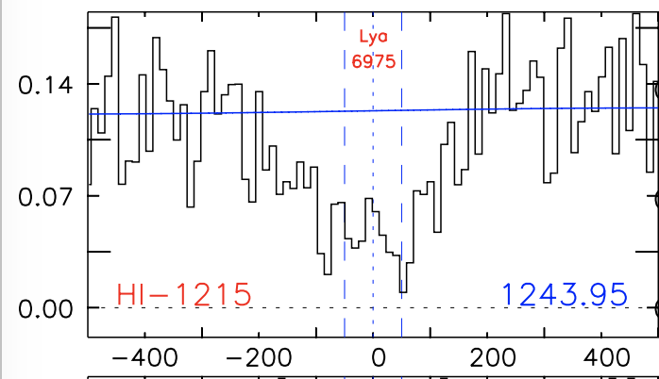
Model sightline velocity structure
The halo – disk kinematic connection
Model the sightline velocity
CGCG039-137 : vhel = 6918 km/s
dv = 57 km/s
French & Wakker 2018, in prep
French & Wakker 2018, in prep

Slide 18
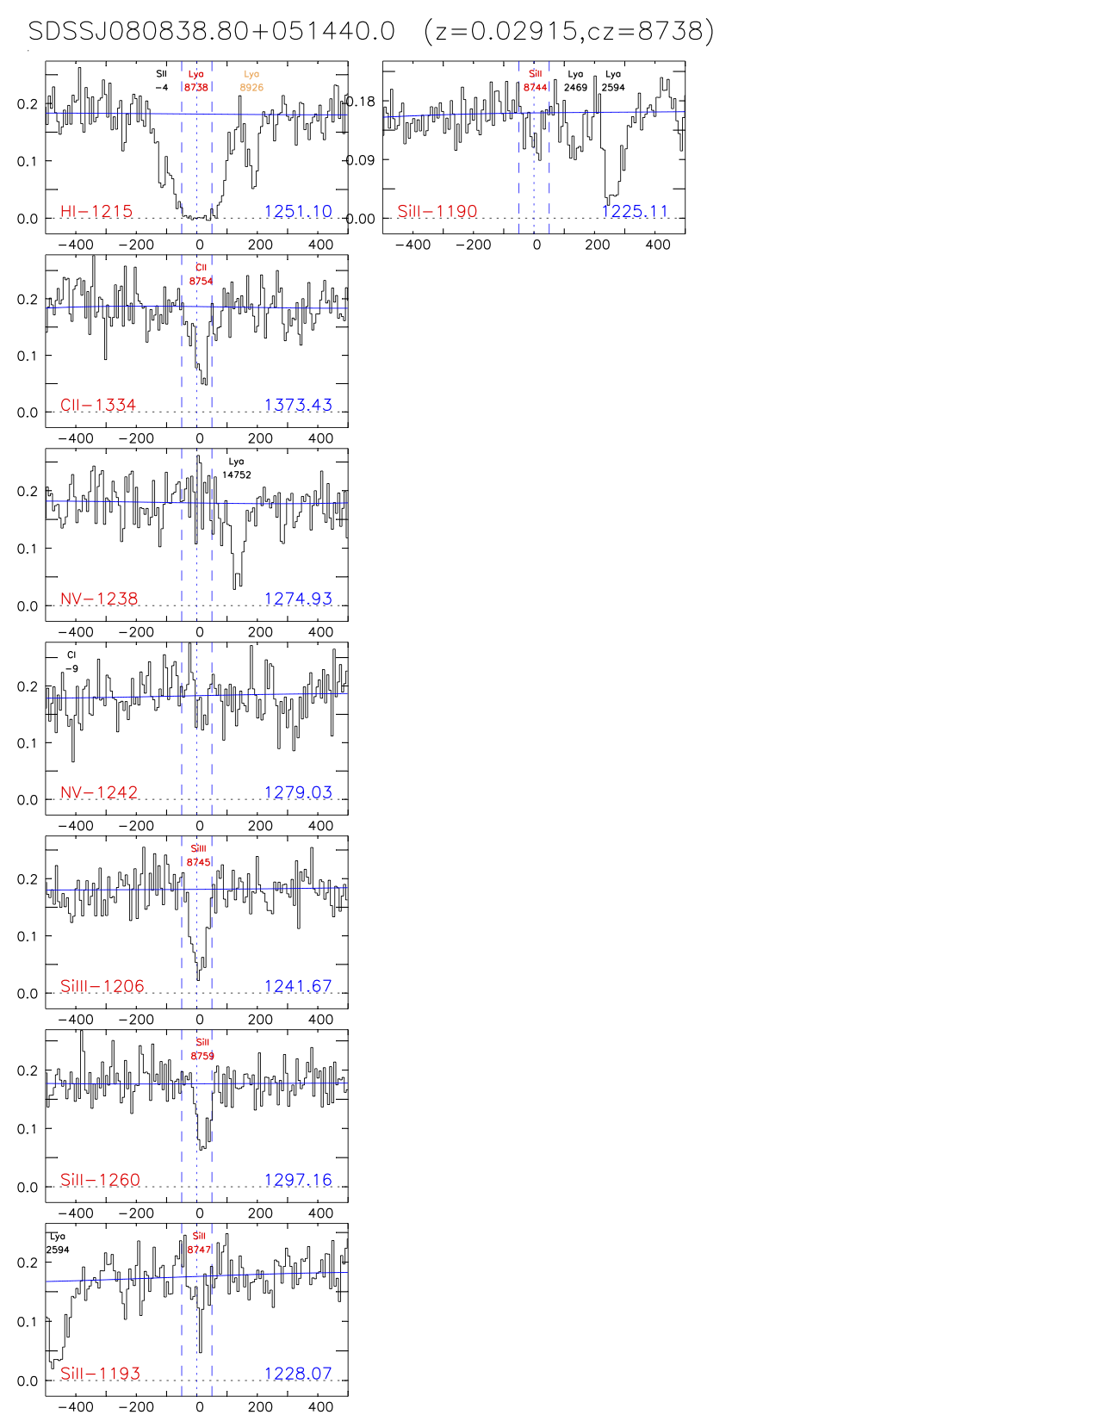
Catalog the absorbers
700+ G130M COS targets
Align, identify and measure all lines
French & Wakker 2018, in prep

Slide 19
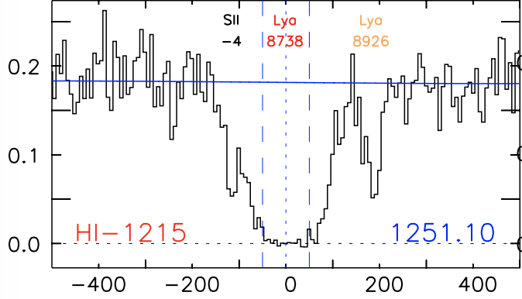
Catalog the absorbers
Connecting with galaxies
How?
French & Wakker 2018, in prep

Slide 20
Catalog the absorbers
Connecting with galaxies – using our galaxy catalog
Which one?
French & Wakker 2018, in prep

Slide 21
Matching absorbers with galaxies
Define an objective likelihood parameter
Define a likelihood:
= impact parameter
= viral radius of the galaxy

Slide 22
Matching absorbers with galaxies
Applying the likelihood method
= 0.00027
= 0.16
French & Wakker 2018, in prep

Slide 23
Preliminary Results
Status:
237 spectra aligned and identified
1067 Ly-alpha absorbers
331 measured
116 ”associated” with a single galaxy

Slide 24
Preliminary Results
EW vs impact parameter:

Slide 25
Preliminary Results
EW vs velocity separation:

Slide 26
Preliminary Results
Inclinations:

Slide 27
Summary:
700+ COS spectra correlated with 130,000+ galaxies
Expect ~3000 Ly-alpha absorbers
~1000 absorber-galaxy pairs using likelihood method
Strong EW – ΔV correlation
Overabundance around highly inclined galaxies
Disk-halo kinematic connection?
Probably not very far reaching
Does CGM gas care about galaxies?
It seems like it might! Stay tuned.

Slide 28
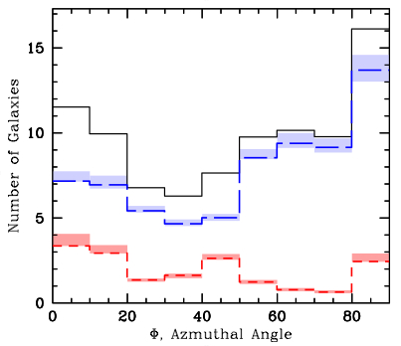
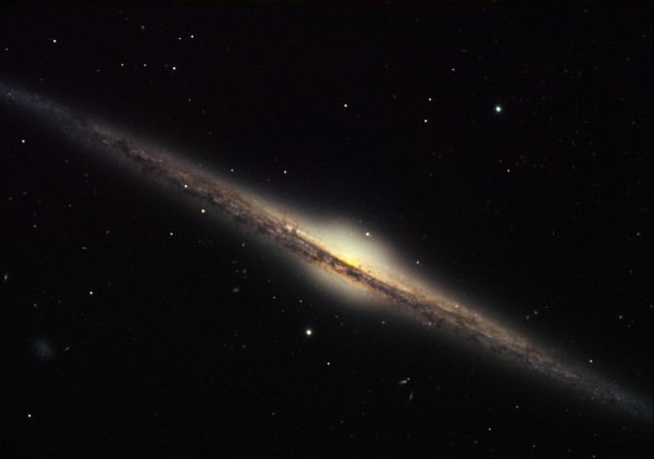
How do CGM absorber properties depend on galaxy orientation?
Major vs minor?
Same for neutral gas?
QSO
Credit: Bruce Hugo & Leslie Gaul, Adam Block, NOAO, AURA, NSF
Kacprzak et al. 2012

Slide 29
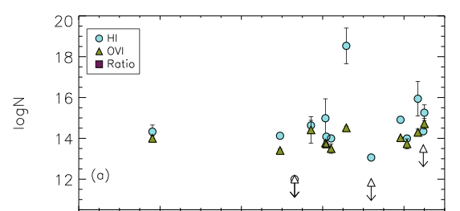
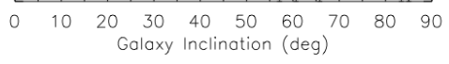
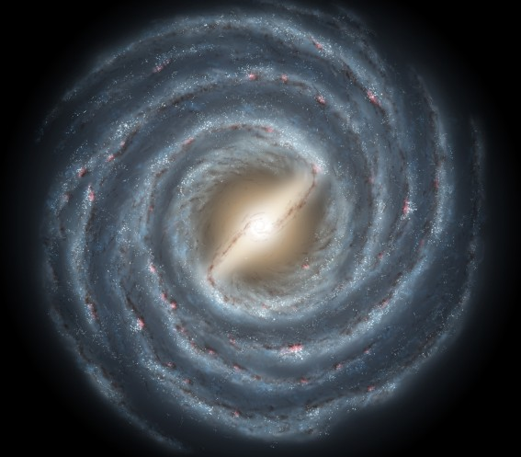
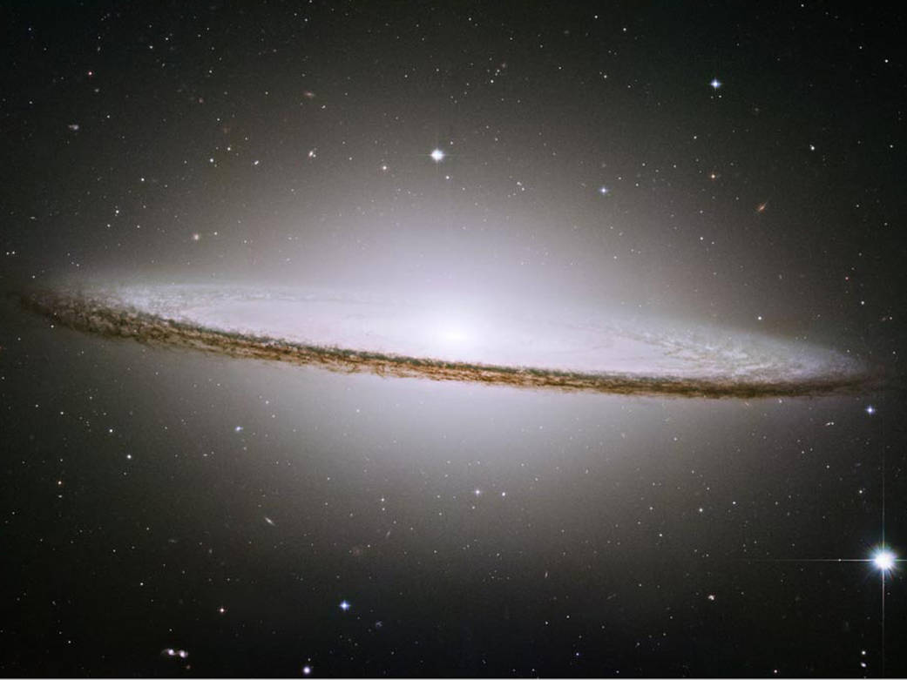
Galaxy Inclination
No?
Mathes et al. 2014
Notes:
TAKE OFF THE BOTTOM PART

Slide 30
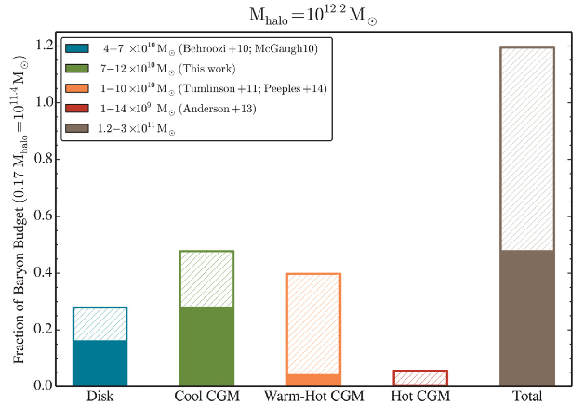
Baryon Budget
Werk et al. 2014, ApJ, 792, 128
Notes:
Green -> Lya (T = 10^4), Orange -> OVI (T = 10^5 – 10^7), Red -> X-rays (T>10^7)

